Slide 1
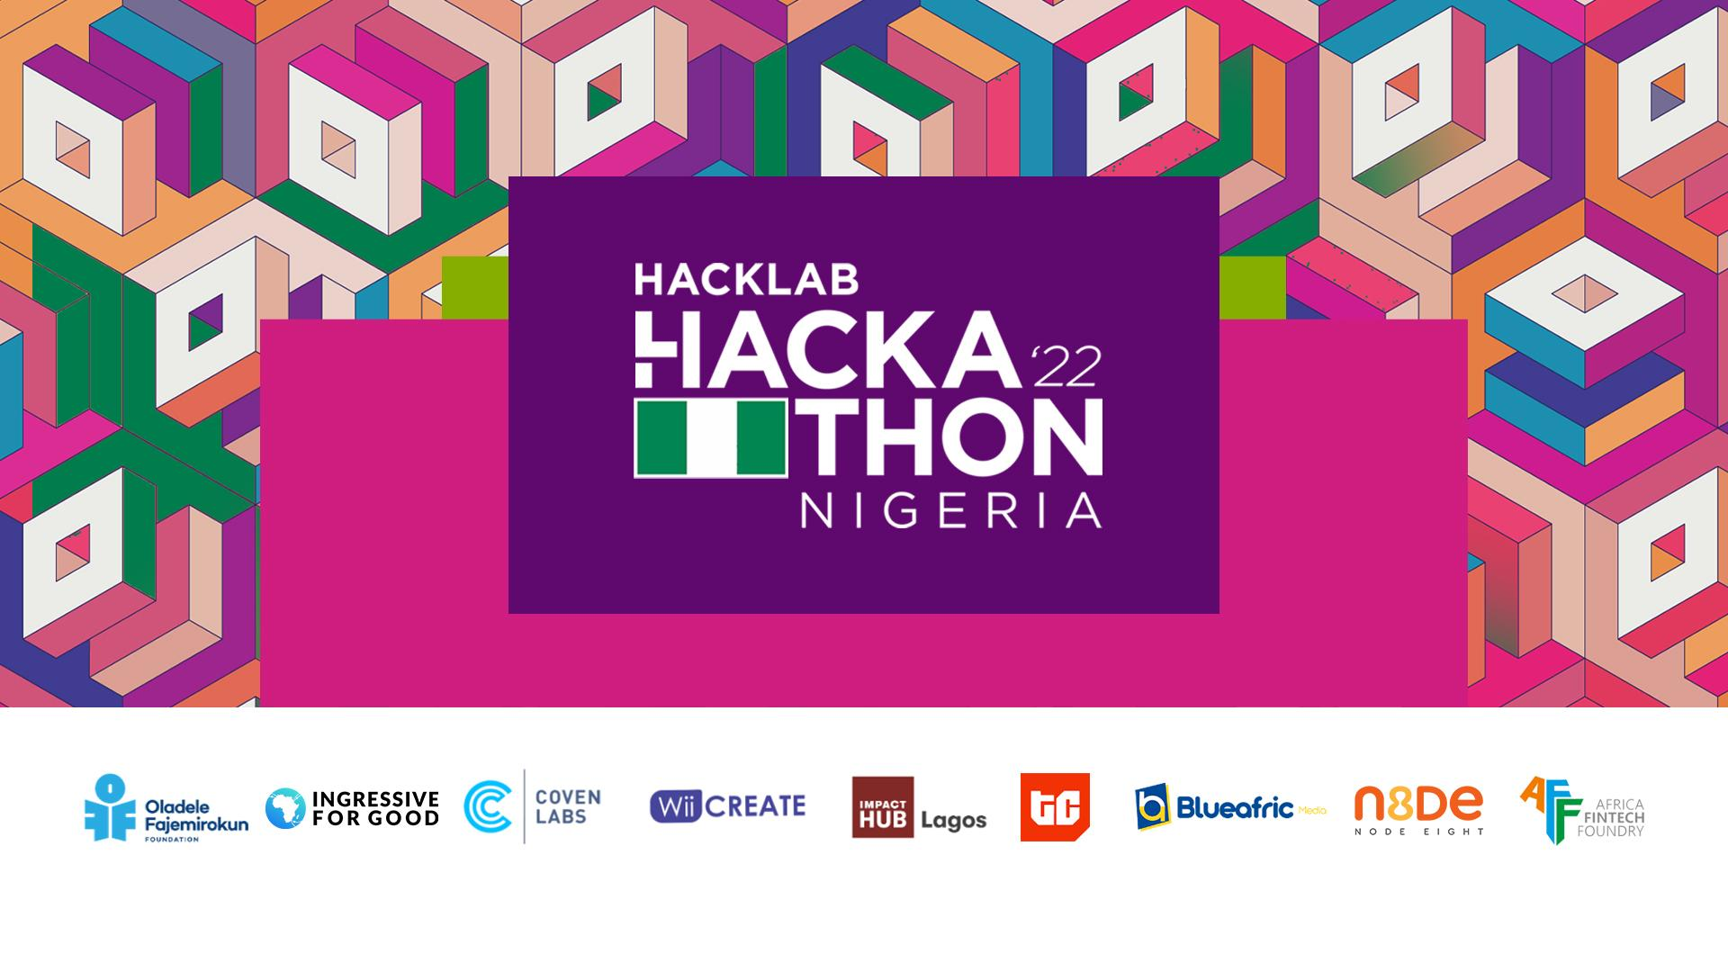

Slide 2

PROBLEM STATEMENT
Despite having Africa's largest economy, Nigeria has a high poverty rate, with only the wealthy having access to adequate health care while the poor are commonly seen self-medicating due to the high cost of medical bills and poor quality of care/attendance in public hospitals. The World Health Organization recommends a doctor-patient ratio of 1:600, yet figures show that Nigeria's doctor-patient ratio is 1:5000 for a population of around 200 million people. This poses a great problem for the average Nigerian to quality healthcare.

Slide 3

CONCEPT
Drect is an AI-integrated telemedicine healthcare solution with the goal of providing better healthcare to the less fortunate while also providing more job prospects for doctors in Nigeria and other developing countries.

Slide 4
HOW THE SOLUTION WORKS
Drect, at its core, is a platform that allows patients to schedule online consultations with doctors. However, it is also an AI(Artificial Intelligence)-powered solution with edge computing capabilities that can be coupled with an IoT device for real-time vitals monitoring, sleep tracking, medicine reminders, and a variety of other functions. Edge computing ensures the security of sensitive data sent between patients and healthcare providers.
The website also offers an individualized AI-powered chatbot capable of performing basic diagnostics and also serves as a virtual assistant to both patients and doctors.
With Drect, a patient may also choose to hire a personal doctor. In the event of abnormalities in patient vitals detected by the IoT device, an emergency signal is issued to both the patient and the doctor.

Slide 5
TECH STACK
Django
Bootstrap
ReactJS
PostgreSQL
redis
Tensorflow
AWS

Slide 6
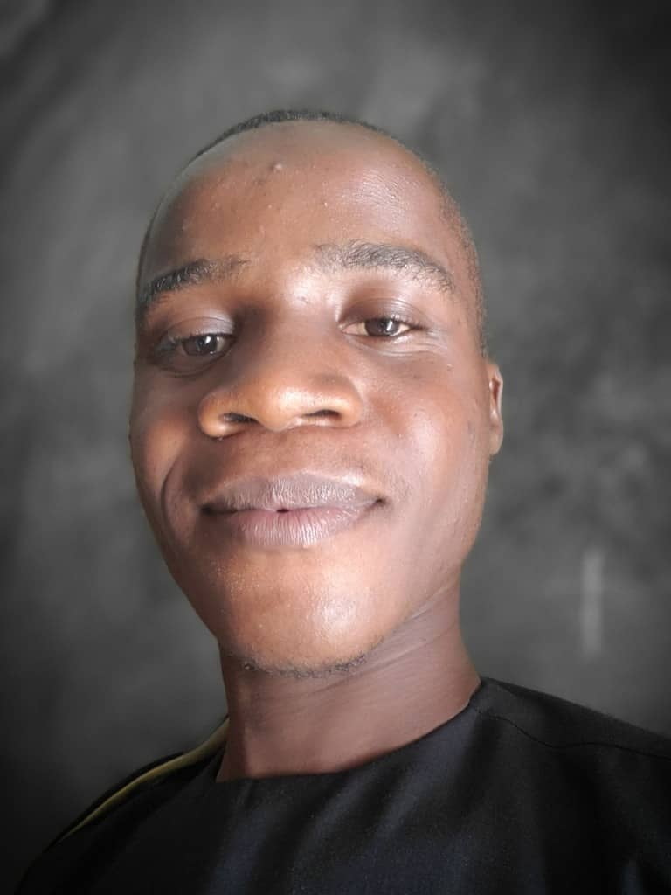
TEAM MEMBERS
Abdulmajid Mahadi Sheriff
Agboola Olamide Aishat
Aberejo Habeeblah Oladipupo

Slide 7

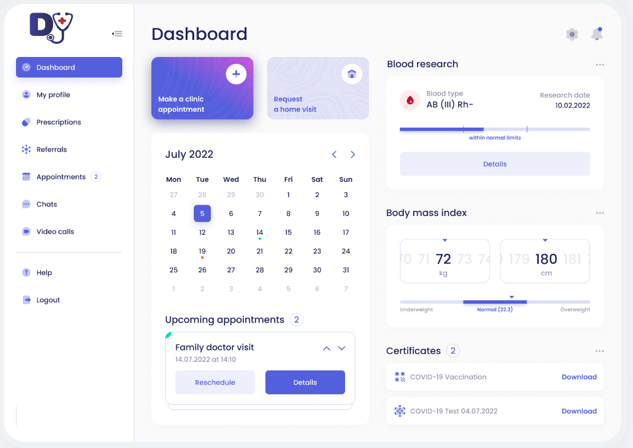
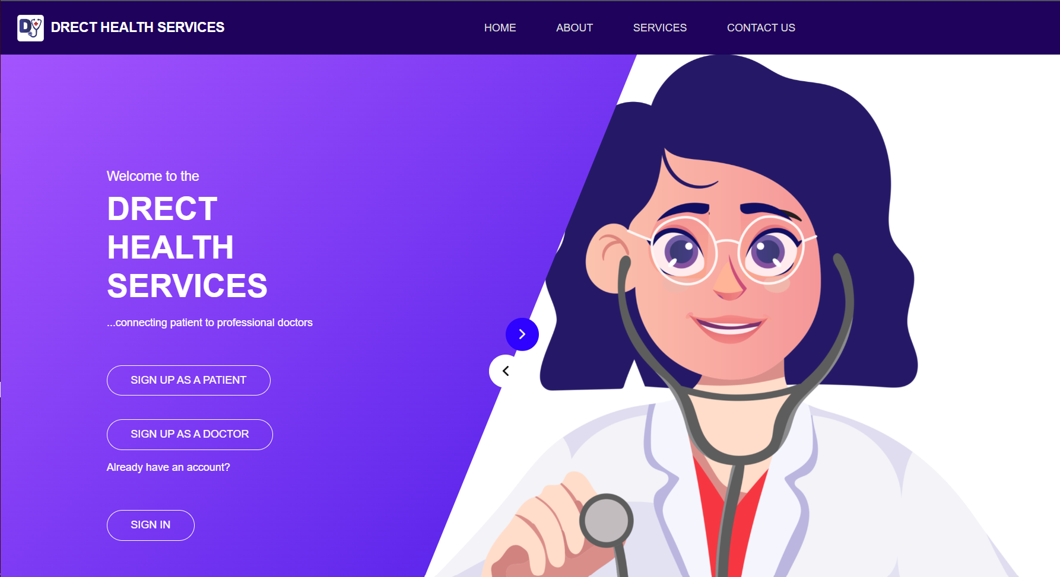
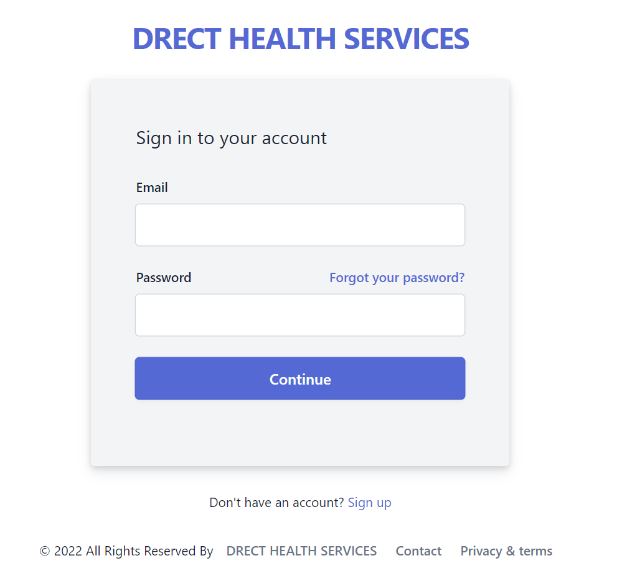
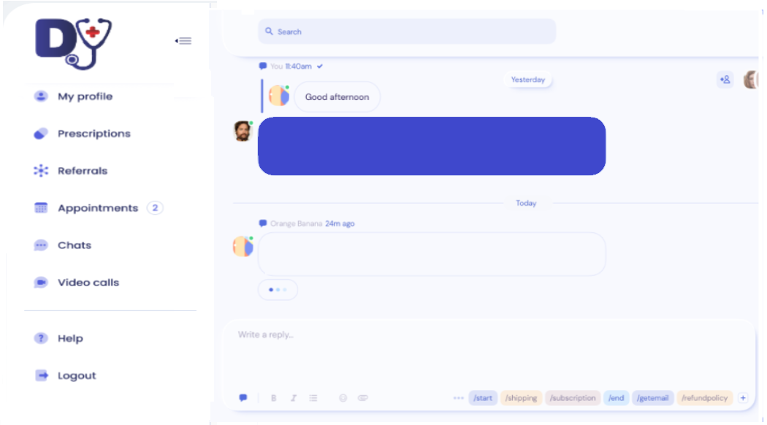
DEMO
Welcome to Drect
View Your Dashboard
Register as a doctor or patient
Patient conversations with doctor

Slide 8
Submit your pitch decks and team pictures to: hacklabprojects@hacklabfoundation.org

